Slide 1
EduVision_DV
Higher Education Performance Dashboard
Project Documentation
2,017
118
47.96
4
Universities
Countries
Avg Global Ranking Score
Interactive Dashboards
Ranking • Research • Students • Country Comparison
EduVision_DV • Higher Education Performance Dashboard
01

Slide 2
1. Dataset Sources
Source → preparation → final analytical dataset
DATA SOURCES
Source Data
Preparation
Final Data
• 2024 rankings workbook
• QS ranking sheet
• THE ranking sheet
• University + country information
• Standardize university names
• Match QS + THE records
• Merge into unified dataset
• university_cleaned_data.csv
• KPI engineering
• university_final_dataset.xlsx
DATA FLOW
QS + THE
Clean
Merge
KPI Engineering
Tableau
Supporting Files
• review_matches.csv • unmatched_universities.csv
EduVision_DV • Higher Education Performance Dashboard
02

Slide 3
2. Dataset Fields
Fields grouped according to the analytics used
Ranking
Academic & Research
Students
Global & KPI
• University Name
• Country
• THE Rank
• QS Rank
• THE Overall Score
• QS Overall Score
• Academic Reputation
• Employer Reputation
• Teaching Score
• Research Score
• THE / QS Citation
• Industry Income
• Faculty Student Score
• Student Staff Ratio
• Number of Students
• International Students %
• International Faculty Score
• International Outlook
• Employment Outcomes
• Sustainability Score
• Global Ranking Score
• Research Impact Score
• Research Productivity Index
EduVision_DV • Higher Education Performance Dashboard
03

Slide 4
3. Data Cleaning
Key preprocessing steps applied before dashboard creation
Missing Values
Text Standardization
• Convert *, N/A, NA and – to missing
• Fill numeric missing values with median
• Trim names and countries
• Normalize spacing
Numeric Conversion
Data Quality
• Convert performance and student fields to numeric
• Handle invalid rank values
• Remove duplicates
• Drop rows with no core performance data
OUTPUT
Clean Dataset
• Cleaned CSV → KPI engineering → university_final_dataset.xlsx
EduVision_DV • Higher Education Performance Dashboard
04

Slide 5
4. KPI Definitions
Derived measures used to summarize university performance
Global Ranking Score
Research Impact Score
Faculty-to-Student Ratio
• QS/THE ranks normalized to 0–100
• Average QS + THE when both exist
• Average of QS + THE Citation Scores
• Based on Student Staff Ratio
International Student %
Academic Reputation Score
Research Productivity Index
• Uses International Students %
• Uses Academic Reputation
• Research performance adjusted for university size
• Normalized to 0–100
Research Performance
• 50% Research Score + 50% Research Impact Score
EduVision_DV • Higher Education Performance Dashboard
05

Slide 6
5. Education Analytics Methodology
Analytical approach used across the four dashboard sections
Ranking Analytics
Research Analytics
Student Analytics
• Extract rank number
• Normalize rank to 0–100
• Combine QS + THE
• Compare universities / countries
• Combine citation scores
• Calculate research performance
• Measure research productivity
• Compare research impact
• Analyze enrollment
• Study international students
• Compare faculty capacity
• Identify diversity patterns
Country Analysis
Visualization
Comparison Levels
• Aggregate university indicators
• Compare key performance measures
• KPI cards • bar charts • maps
• Treemap • scatter • bubbles • donut
• University level
• Country level
• Global level
Goal
• Turn complex ranking data into interactive, understandable comparisons.
EduVision_DV • Higher Education Performance Dashboard
06

Slide 7
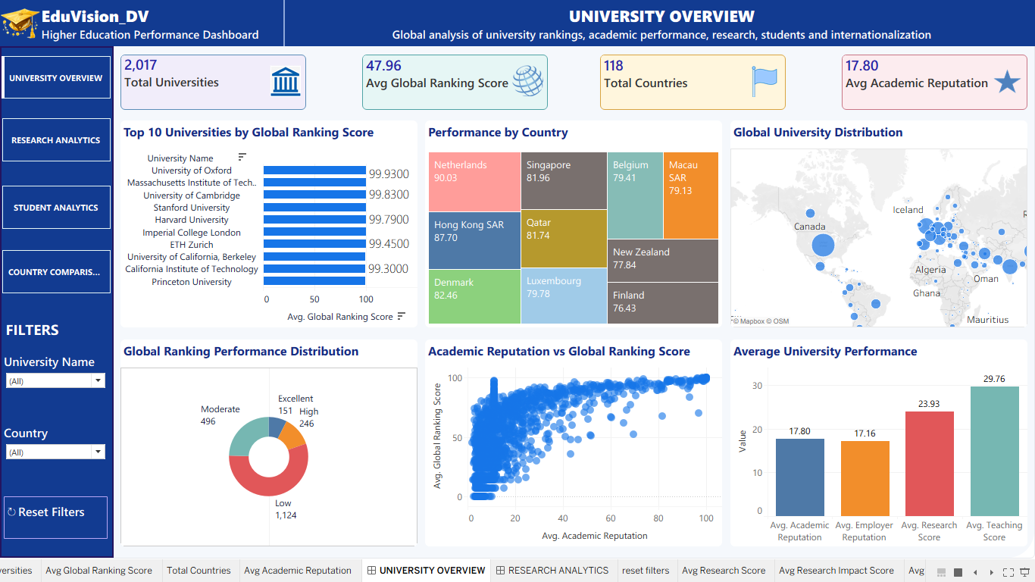
7. UNIVERSITY OVERVIEW
Overall ranking, academic reputation and global distribution
Purpose
• University performance.
• Ranking and Reputation comparisons.
Main Visuals
• Top 10 Universities by Global Ranking Score
• Performance by Country
• Global University Distribution map
• Ranking distribution + reputation scatter
KPI Cards
• Total Universities
• Avg Global Ranking Score
• Total Countries
• Avg Academic Reputation
Filters
• University Name
• Country
• Reset Filters
Explain: KPI → visuals → insight
EduVision_DV • Higher Education Performance Dashboard
07

Slide 8
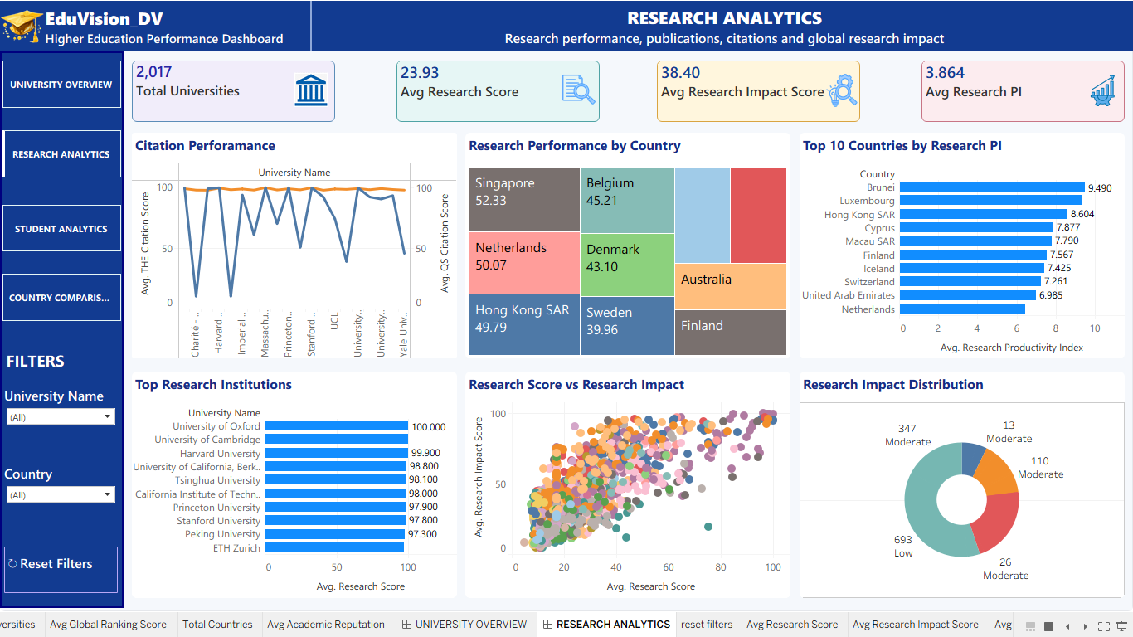
8. RESEARCH ANALYTICS
Research performance, citations and global research impact
Purpose
• Focuses on research strength and impact.
• Supports institution and country-level comparison.
Main Visuals
• Citation Performance
• Research Performance by Country
• Top Research Institutions
• Research Score vs Research Impact
KPI Cards
• Total Universities
• Avg Research Score
• Avg Research Impact Score
• Avg Research PI
Filters
• University Name
• Country
• Reset Filters
Explain: KPI → visuals → insight
EduVision_DV • Higher Education Performance Dashboard
08

Slide 9
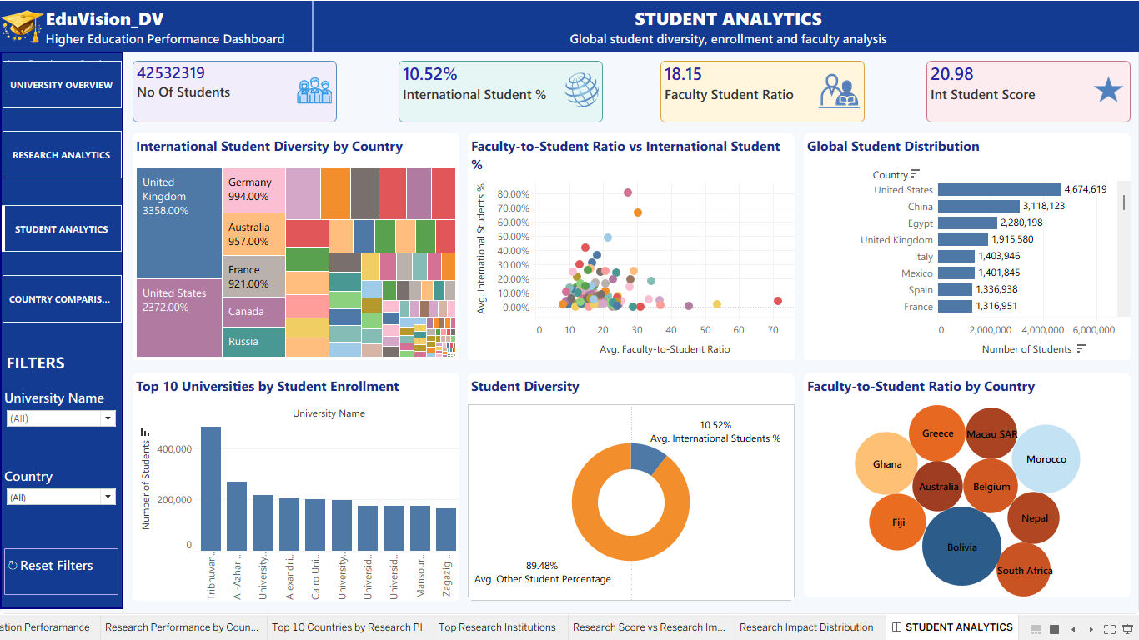
9. STUDENT ANALYTICS
Student enrollment, diversity and faculty capacity
Purpose
• Examines student scale and internationalization.
• Connects student diversity with faculty capacity.
Main Visuals
• International Student Diversity by Country
• Global Student Distribution
• Top 10 Universities by Student Enrollment
• Student Diversity donut
KPI Cards
• Number of Students
• International Student %
• Faculty-to-Student Ratio
• International Student Score
Filters
• University Name
• Country
• Reset Filters
Explain: KPI → visuals → insight
EduVision_DV • Higher Education Performance Dashboard
09

Slide 10
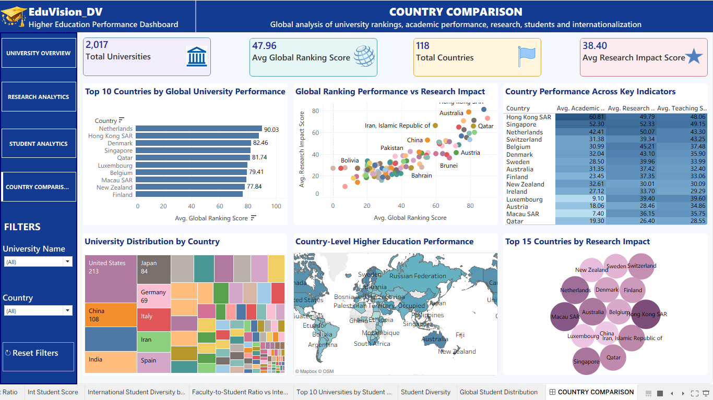
10. COUNTRY COMPARISON
Country-level view of higher education performance
Purpose
• Compares countries using aggregated university indicators.
• Highlights differences across ranking, research and teaching.
Main Visuals
• Top 10 Countries by Global University Performance
• Ranking vs Research Impact scatter
• Country Performance heatmap
• University Distribution by Country
KPI Cards
• Total Universities
• Avg Global Ranking Score
• Total Countries
• Avg Research Impact Score
Filters
• University Name
• Country
• Reset Filters
Explain: KPI → visuals → insight
EduVision_DV • Higher Education Performance Dashboard
10

Slide 11
11. Dashboard Usage
How a user interacts with EduVision_DV
SELECT
CHECK
COMPARE
01
02
03
Choose University / Country
Read KPI summary
Use charts and maps
ANALYZE
EXPLAIN
RESET
04
05
06
Find patterns
Relate to KPI meaning
Return to default view
Key Point
• The dashboard converts complex ranking data into quick visual comparisons and decision-support views.
EduVision_DV • Higher Education Performance Dashboard
11

Slide 12
12. End-to-End Project Summary
From raw ranking data to interactive education analytics
QS + THE Data
Cleaning
Merging
KPI Engineering
Final Dataset
Tableau
Technology
Main Outputs
Analytics Areas
• Python • Pandas • NumPy
• Excel • Tableau
• Clean dataset + engineered KPIs
• 4 interactive dashboards
• Ranking • Research
• Students • Countries
Project Outcome
• A unified visual system for exploring global higher-education performance.
EduVision_DV • Higher Education Performance Dashboard
12

